Slide 1

ABDUR RAZZAK
2221081081
A Plagiarism Checker.

Slide 2



Presented By
Presented To -
Abdur Razzak 2221081081
Jobaer Islam 2221081010
Mahfuzur Rahman 2221081139
Nahida Islam
Lecturer Dept. of CSE, UU
27 Nov, 2024

Slide 3


Introduction
Overview
Purpose of the System
Objective
Outline-
System Architecture
Diagrams
Future Work
Conclusion

Slide 4
Introduction -
Plagiarism detection is crucial for maintaining academic and professional integrity.
Sotota Checker is a user-friendly website that uses a third-party API to verify originality in text and documents. It offers a free one-month trial, a free service month for subscribers, and 2-Step verification for security. Future plans include Generative AI integration.
01

Slide 5

Overview -
What is Sotota Checker?
● An online plagiarism detection tool to verify text or document originality.
● Uses third-party API to compare against large databases.
Key Benefits:
● Fast plagiarism detection.
● Results with similarity scores and highlighted copied content.
● Secure, user-friendly interface with 2-Step verification.
● Free one-month trial and free month for subscribers.
02

Slide 6

Purpose of the System -
Main Purpose: Provide a reliable, accessible tool for detecting plagiarism.
Target Users: Students, educators, writers, and professionals.
03

Slide 7




Objectives -
To Provide Accurate
Plagiarism Detection
To Ensure User-Friendly
Design
To Deliver Fast and
Secure Results
To Ensure Security And
Data Privacy
04

Slide 8




System
Architecture -
API:
Third-party plagiarism detection API
Frontend:
HTML, CSS, JavaScript
Backend:
Node.js, Express.js
Database:
MongoDB
05

Slide 9
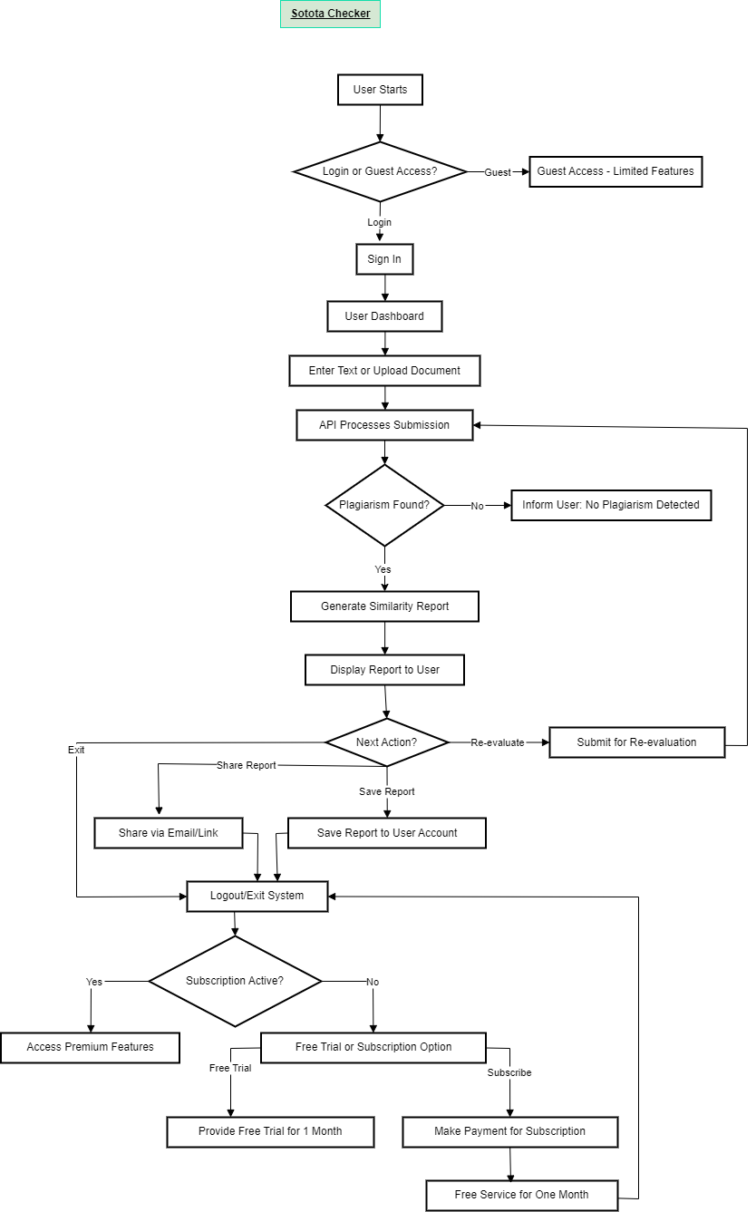
Flow Chart -
06

Slide 10
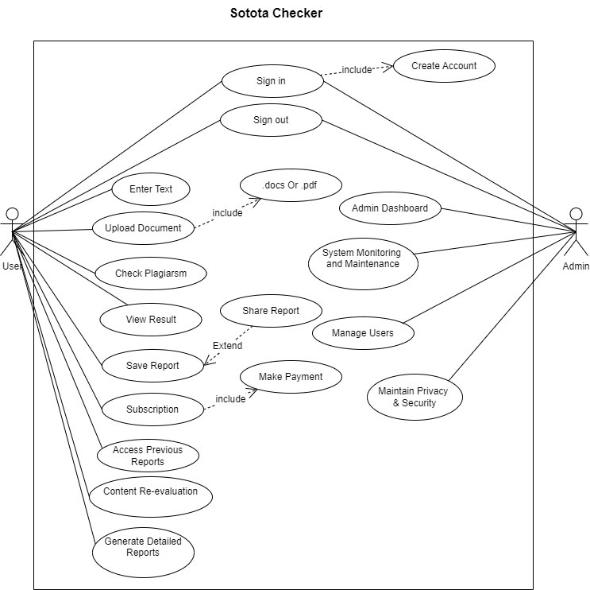
Use Case
Diagram-
07

Slide 11
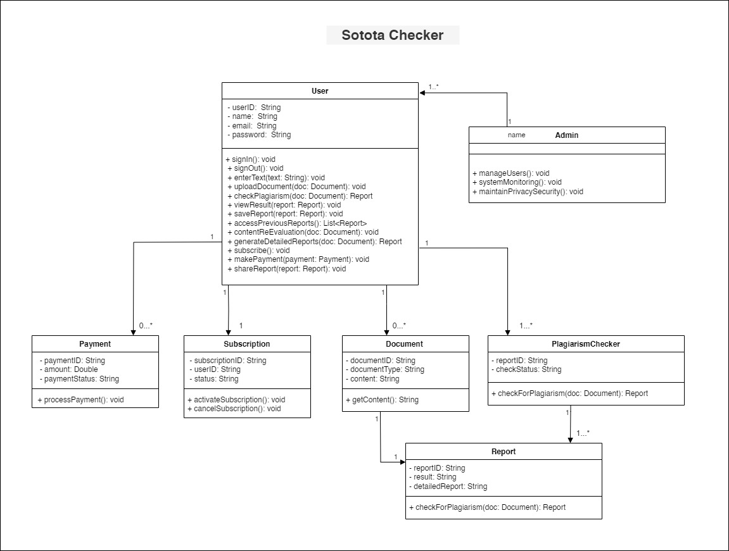
Class
Diagram-
08

Slide 12
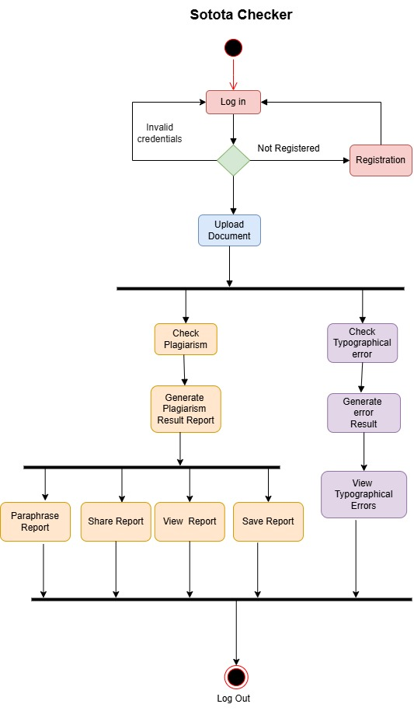
Activity
Diagram-
09

Slide 13
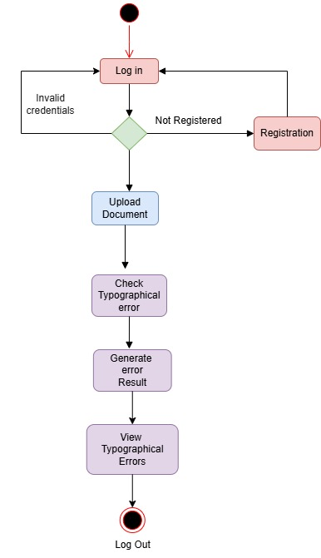
Activity
Diagram-
Typographical Check
10

Slide 14
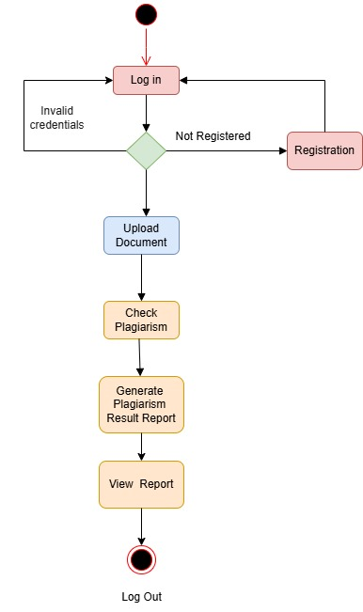
Activity
Diagram-
Plagiarism Check
11

Slide 15
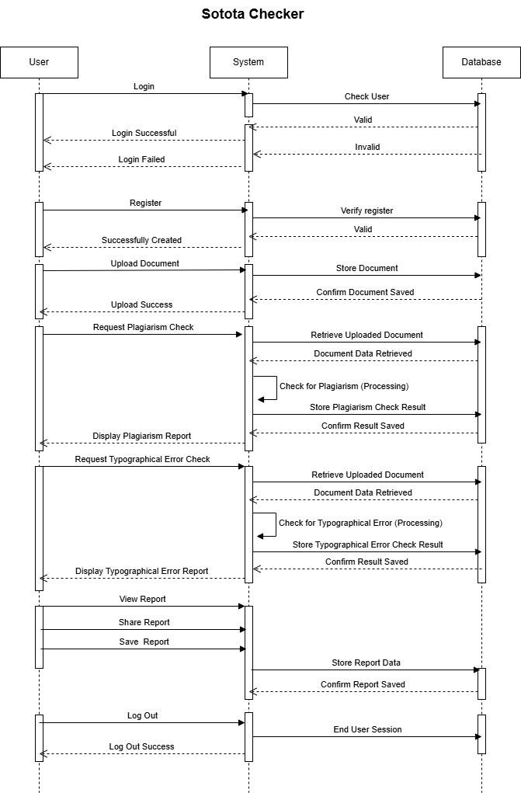
Sequence
Diagram-
12

Slide 16
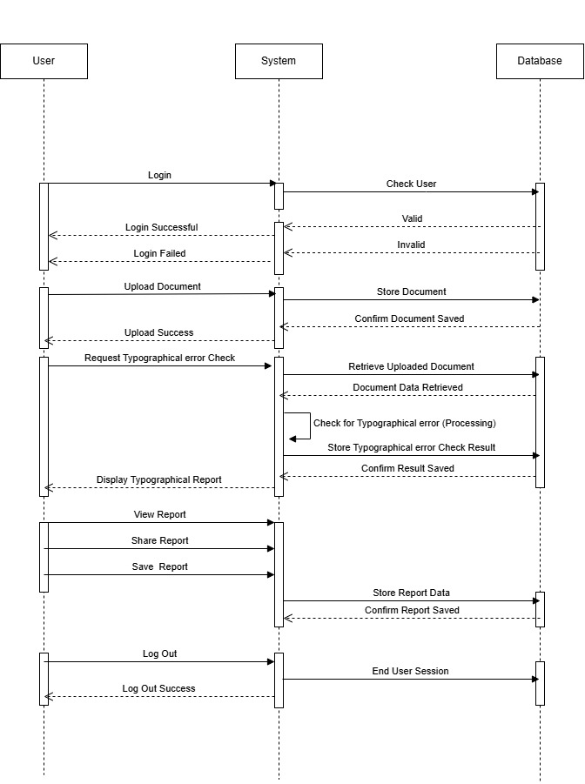
Sequence
Diagram-
Typographical Check
13

Slide 17
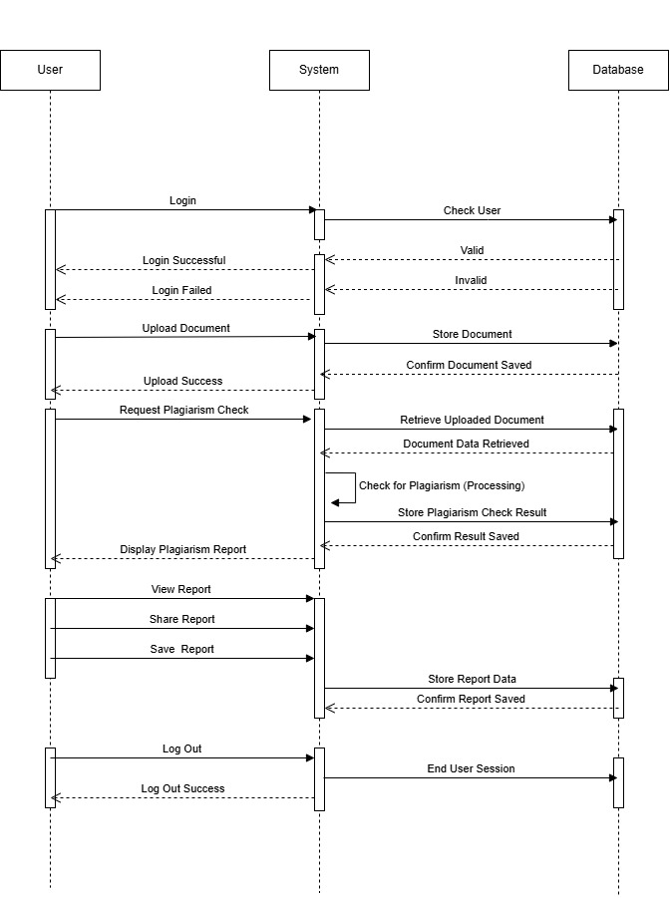
Sequence
Diagram-
Plagiarism Check
14

Slide 18
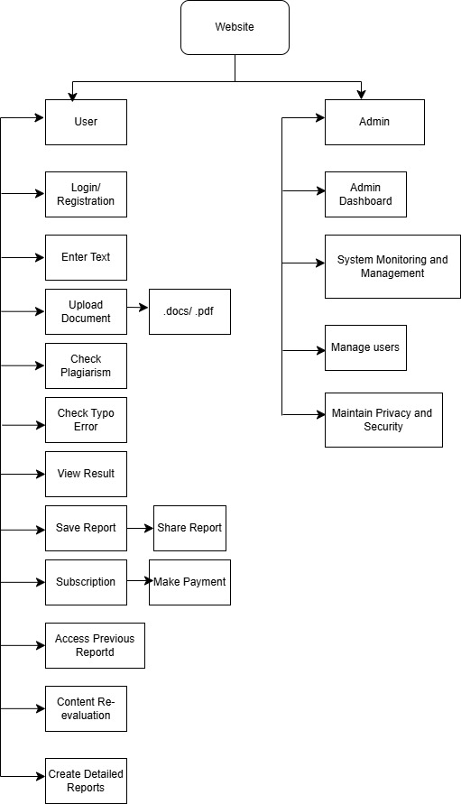
Decomposition
Diagram-
15

Slide 19
Future Work -
Expansion :
● Integration with more APIs for broader content checks.
● Future subscription models with detailed reports and analytics.
● Free trial and subscriber benefits.
Research & Development: :
● Implement Plagiarism Checker
● Generative AI for advanced plagiarism detection.
● Machine learning models for improved accuracy.
● Detecting paraphrased and cross-language plagiarism.
16

Slide 20
Conclusion -
Summary: Sotota Checker will promote originality and integrity in writing, offering fast and accurate plagiarism detection.
Outcomes & Benefits: Free trials, secure 2-Step verification, and future integration of AI for advanced features.
17

Slide 21
If You Want to Visit Our System?
Click Here
Ctr + Click
18

Slide 22

Conclusion -
thanks
Basically, I find the problems of traditional learning system and create a system, there every students can learn from everywhere.

